Slide 1


Imagine Amazon, Netflix, Flipkart, Google, or Paytm —
do you think they process their data using Excel or normal Python pandas?
Every second, millions of transactions, clicks, searches, and sensor logs are generated.
A normal system cannot process such huge volumes of data quickly.
This is where Apache Spark comes into the picture.
PySpark allows us to process terabytes to petabytes of data in minutes, not hours

Slide 2
When organizations such as Amazon, banks, or telecom companies generate massive amounts of data, they need a system to store and process this huge data. This is where Hadoop comes into the picture.
1
Hadoop is a framework that allows large datasets to be stored across multiple machines using a distributed storage system called HDFS (Hadoop Distributed File System).
2
Once data is stored, it needs to be processed. Traditionally, Hadoop used a processing engine called MapReduce, which processes data in batch mode, meaning large amounts of stored data are processed at scheduled times, such as generating daily reports. MapReduce processes data from disk repeatedly, which makes it slower.
3
2
Although Hadoop was powerful, industries required faster processing, especially for machine learning, streaming analytics, and interactive queries. This need led to the development of Apache Spark.
For querying the stored data using SQL-like commands, tools such as Hive are used. Hive allows users to run SQL queries on large datasets without writing complex programming code
5
To manage all machines in the cluster, Hadoop uses YARN, which acts as a resource manager, deciding which machine should run which job.
4

Slide 3
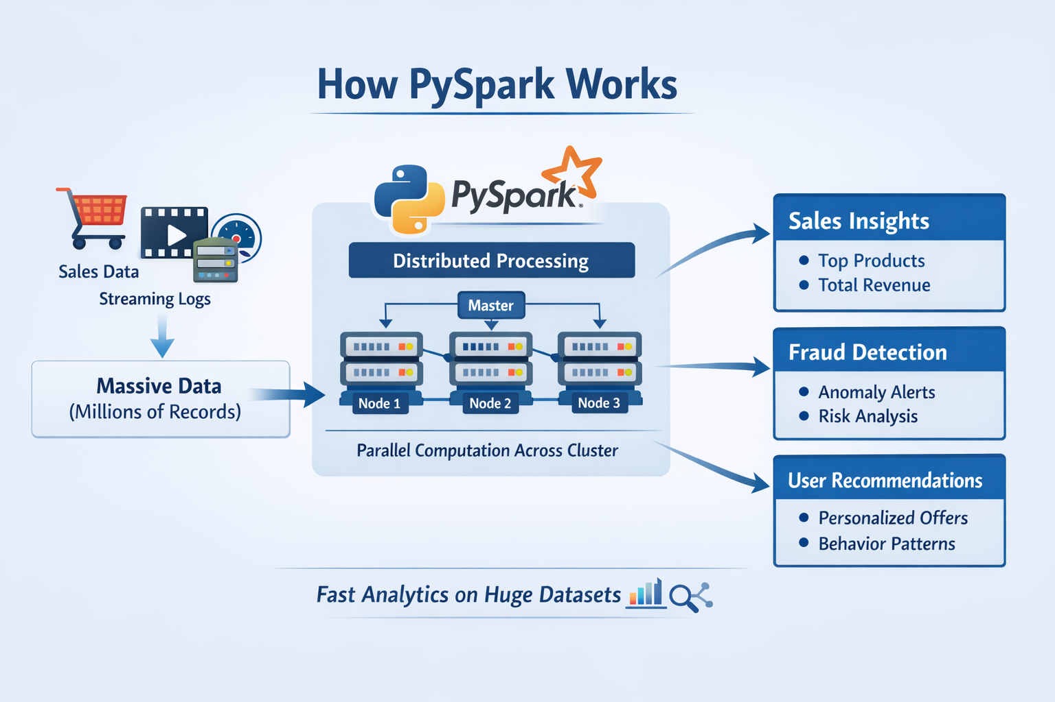

Slide 4


Apache Spark is a distributed big-data processing engine designed to process extremely large datasets across multiple computers simultaneously. “Apache” comes from the Apache Software Foundation, the open-source organization that maintains the project.
PySpark is the Python API for Apache Spark. “Py” = Python “Spark” = distributed processing engine So PySpark = Using Python language to work with Apache Spark.
PySpark is the Python interface for Apache Spark that enables large-scale distributed data processing using Python. It allows developers and data engineers to process terabytes to petabytes of data efficiently across clusters of machines through parallel computation and in-memory processing. PySpark allows us to write big-data processing programs in Python while Spark performs the computation in parallel across many machines, making large-scale analytics extremely fast.

Slide 5
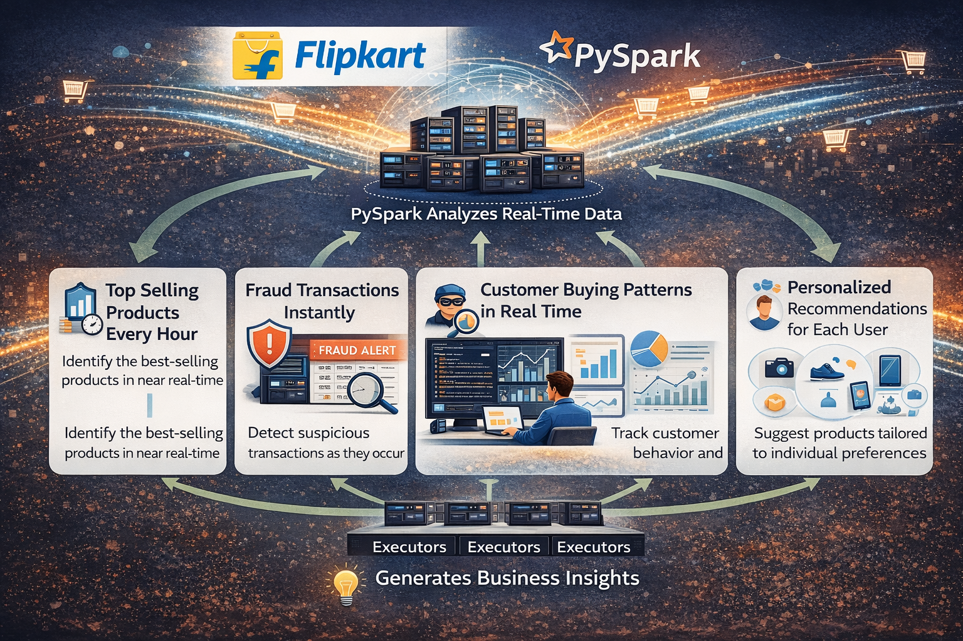
E-commerce Recommendation System

Slide 6
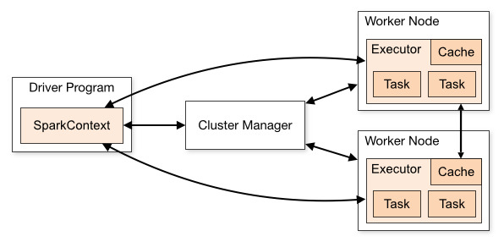
A cluster is a collection of multiple machines connected together to process large datasets in parallel under the coordination of a cluster manager.
Driver
Brain of the application
Sends tasks
Cluster Manager
Resource allocator
Decides which machine runs which task
Worker Nodes
Actual machines in the cluster
Run executors
Executors
Run tasks
Process partitions of data
STEP 1
(Driver Program)
│
▼
STEP 2: Work divided into tasks
│
▼
STEP 3: Tasks sent to Cluster
│
▼
STEP 4: Executors compute in parallel
│
▼
STEP 5: Results returned
│
▼
STEP 6: Driver shows / stores output

Slide 7
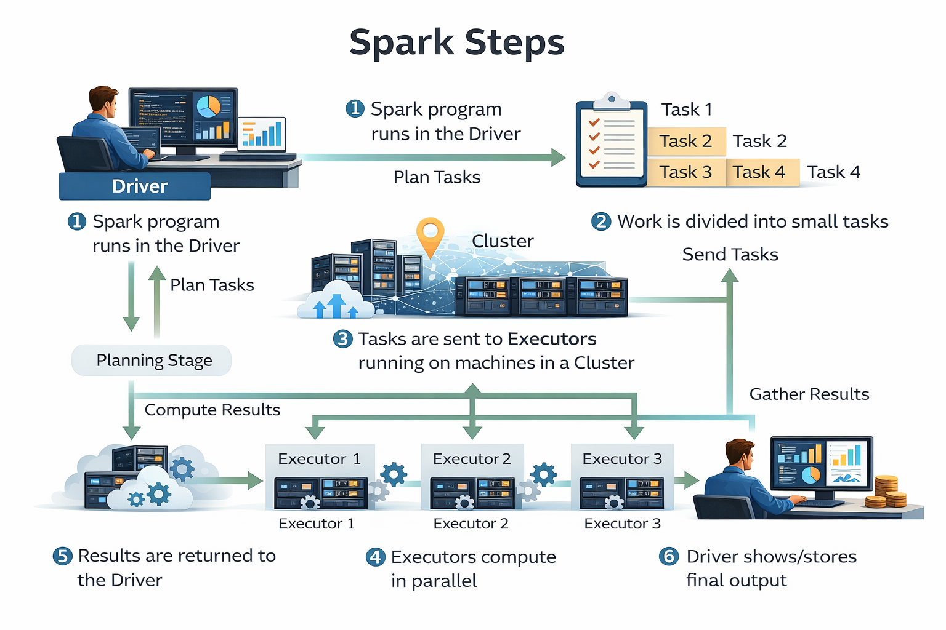

Slide 8
Spark is a distributed computing engine designed for high-speed big-data processing.
Unlike MapReduce, Spark performs in-memory processing, meaning it processes data directly in RAM instead of repeatedly reading from disk
Spark follows an intelligent execution model called lazy evaluation
Spark can be 10 to 100 times faster than traditional Hadoop processing.

Slide 9
Lazy Evaluation
Spark first records the steps (plan) and waits.
When we ask for the final result, Spark executes
In Spark, operations are not executed immediately when we write them.
df1 = df.select("name", "marks")
df2 = df1.filter(df1.marks > 60)
df2.show()
select() and filter() are transformations
Spark only builds the logical execution plan
No computation happens yet
When show() is called:
Spark executes all previous transformations
Tasks are sent to executors
Results are returned to the driver
Now computation actually happens.
(only Planning — no Execution)
Execution happens here

Slide 10
Advantages of Lazy Evaluation
Spark can combine multiple steps into one optimized execution
Reduces unnecessary data reading
Improves performance significantly
Enables better parallel execution
“Spark waits… plans… then executes when an action is called.”

Slide 11
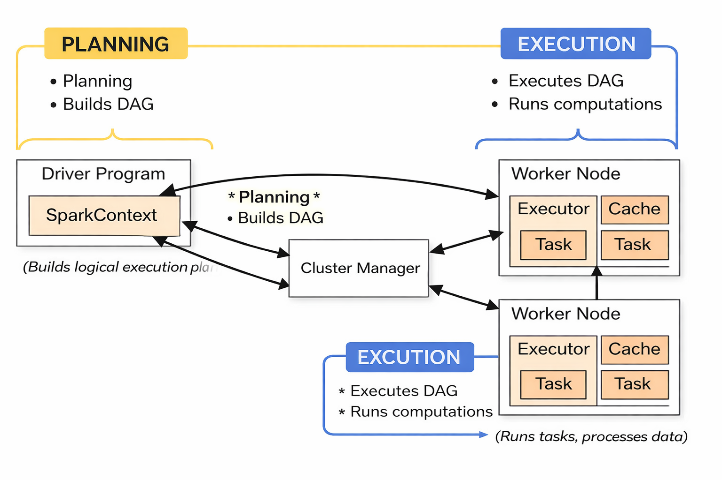

Slide 12
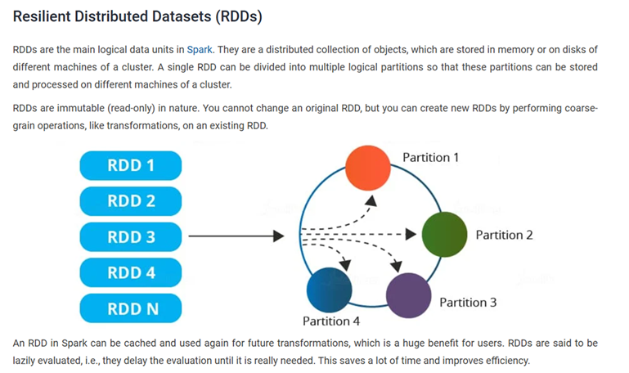

Slide 13
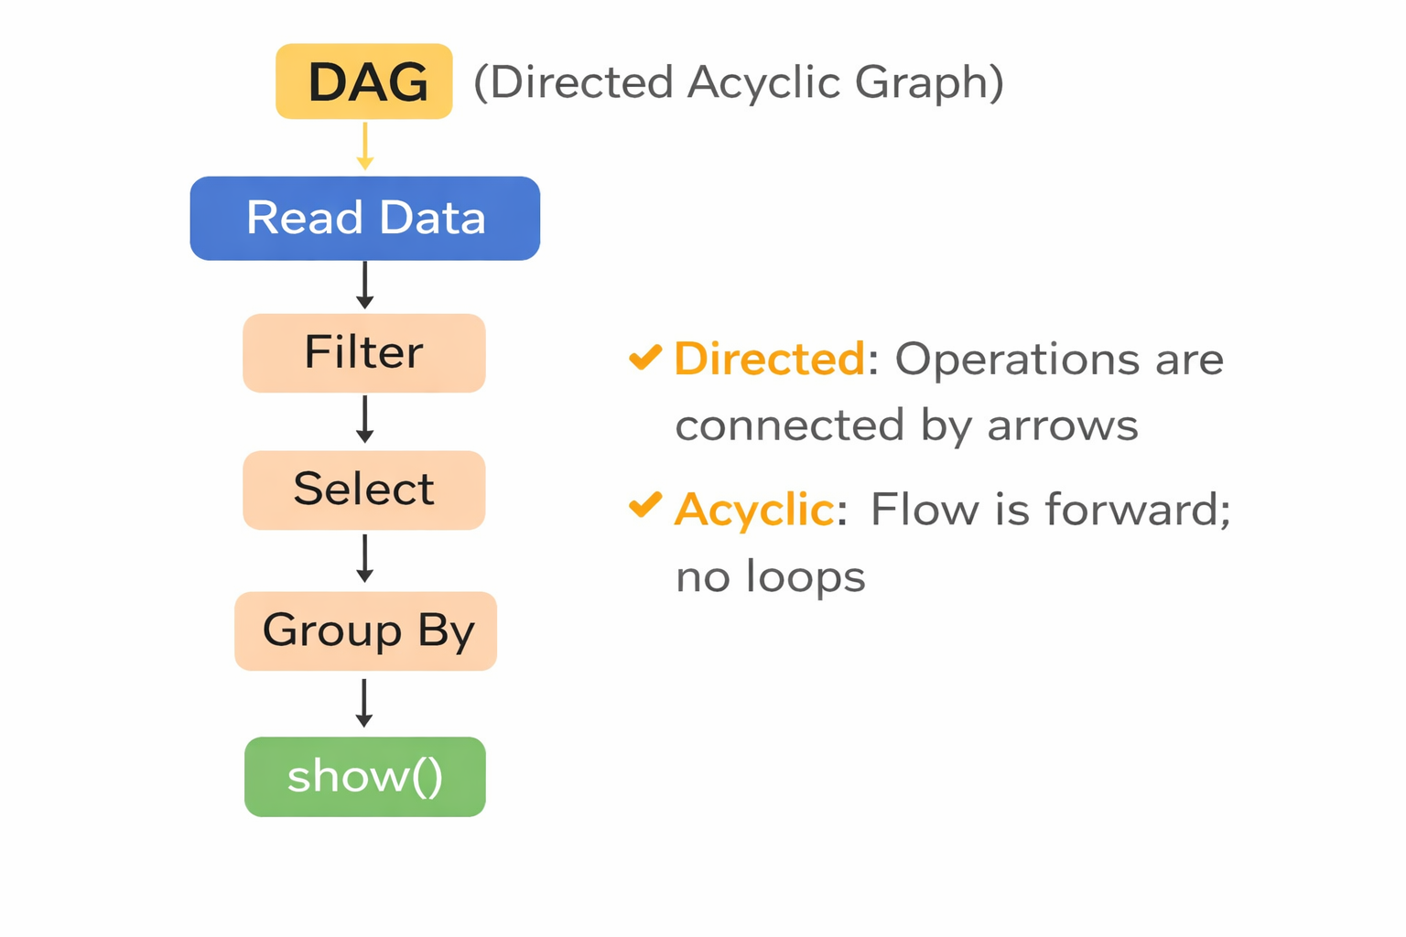
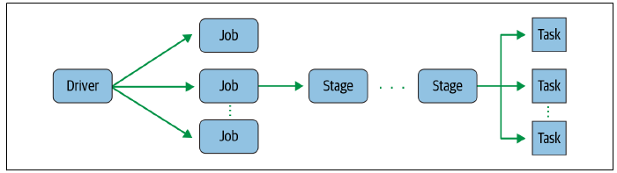
A DAG is “directed” because the operations are executed in a specific order, and “acyclic” because there are no loops or cycles in the execution plan.
Each stage in the DAG depends on the completion of the previous stage, and each task within a stage can run independently of the others.
At a high level, a DAG represents the logical execution plan of a Spark job.
https://medium.com/plumbersofdatascience/understanding-spark-dags-b82020503444

Slide 14
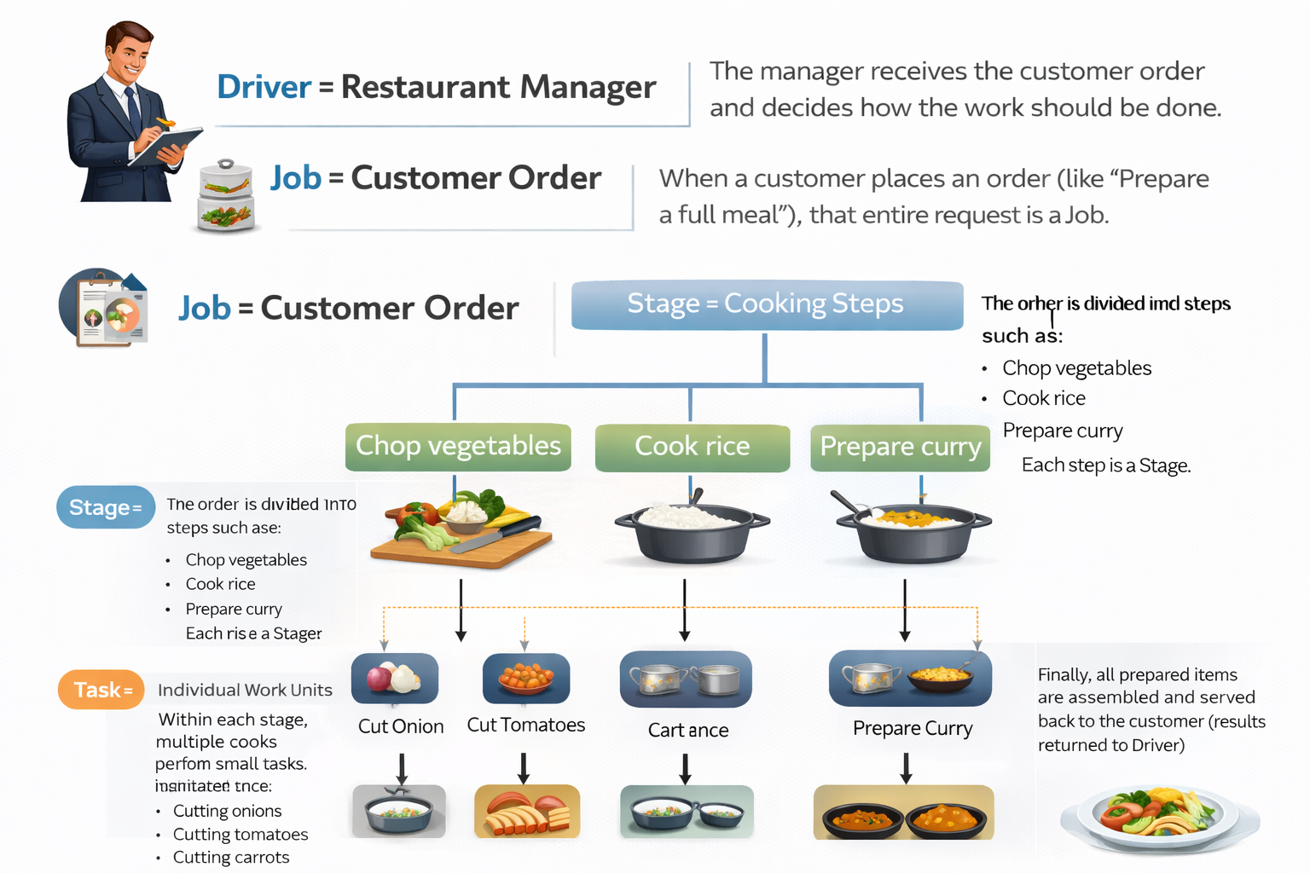

Slide 15

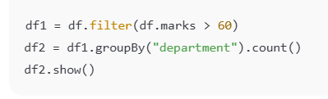
Suppose we have a dataset containing 1000 records, and Spark divides it into 5 partitions. Outcome: Count number of entries
Step 1 — Action triggers a Job
Spark creates 1 Job because an action is triggered.
Step 2 — Job divided into Stages
Assume the computation requires:
Filter records
GroupBy calculation
Spark creates 2 Stages:
Stage 1: Filter
Stage 2: GroupBy (shuffle stage)
Step 3 — Each Stage divided into Tasks
Since the dataset has 5 partitions,
each stage creates 5 tasks.
Action creates Job
Job creates Stages
Stages create Tasks
Component | Count
Job | 1
Stages | 2
Tasks per stage | 5
Total tasks executed | 10

Slide 16

Databricks
Databricks is a cloud platform that provides a managed Apache Spark environment for large-scale data processing and analytics.
Spark → Software framework used to process big data in distributed systems
Databricks → Cloud-based environment that provides ready-to-use Spark clusters, notebooks, and tools to run Spark programs without manual setup
community.cloud.databricks.com/login.html

Slide 17
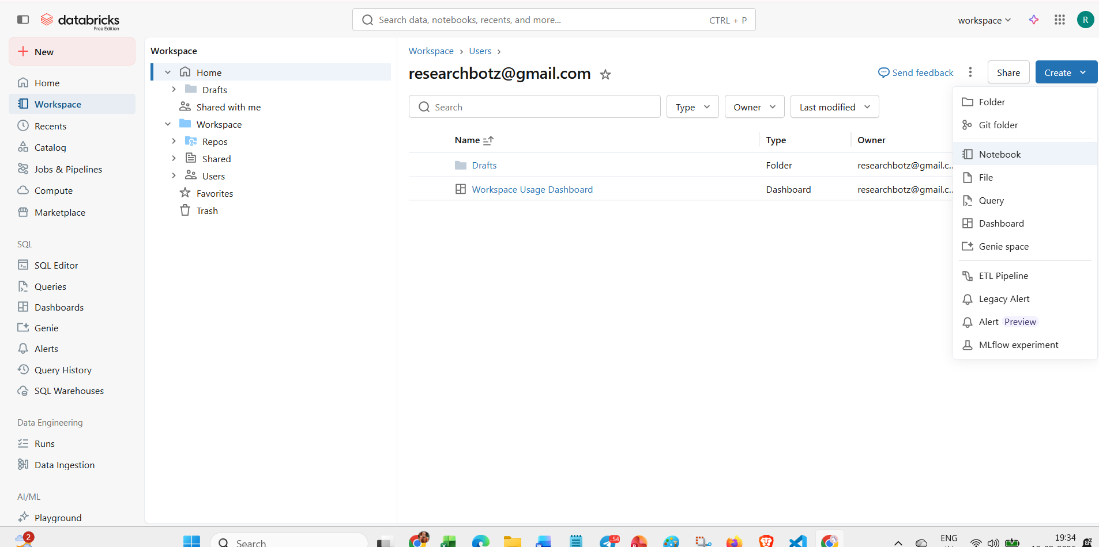

Slide 18
SparkSession
SparkSession is the entry point that establishes a working connection between the user application and Spark cluster for executing distributed data processing operations.
Think of SparkSession like logging into an online banking system.
Logging in → Session starts
You can perform operations (transfer money, check balance)
Logout → Session ends
Similarly:
SparkSession starts → Spark operations allowed
Session ends → connection closes

Slide 19
SparkSession vs SparkContext in PySpark
Before Spark 2.0 (Older Approach)
We needed multiple contexts:
SparkContext → Used to connect to the Spark cluster and run core Spark operations.
SQLContext → Used to work with structured data (DataFrames and SQL queries).
HiveContext → Used to work with Hive tables and Hive SQL.
So programmers had to manage three different objects.

Slide 20
SparkSession vs SparkContext in PySpark
After Spark 2.0 (Modern Approach)
Spark introduced SparkSession, which combines all these contexts into a single unified interface:
SparkSession internally includes:
SparkContext
SQLContext
HiveContext
So now we only create one object:
spark = SparkSession.builder.getOrCreate()

Slide 21
SparkSession vs SparkContext comparison
Feature | SparkContext | SparkSession
Definition | Original entry point to Apache Spark | Modern unified entry point introduced in Spark 2.0
Main Purpose | Used for core Spark operations and cluster connection | Used for DataFrame, SQL, streaming, and ML operations
Level | Low-level API | High-level unified API
Structured Data Support | Requires SQLContext and HiveContext for SQL/DataFrames | Directly supports SQL and DataFrames
Hive Integration | Needs HiveContext separately | Hive support included internally
Relationship | Independent object | Internally contains SparkContext
Usage in Modern Spark | Mostly used internally | Recommended and commonly used entry point

Slide 22
“Upload to a Volume” screen — that is allowed.
Create a volume:
In that upload dialog, click Create volume
Choose:
Catalog: workspace
Schema: default
Volume name: ecommerce_bronze
Upload the CSV there.

Slide 23
What is Parquet?
Parquet is a columnar file format used to store large amounts of data efficiently in big data systems like Spark, Hadoop, Hive, etc.
Full name: Apache Parquet
Key Features of Parquet
Feature | Explanation
Columnar storage | Stores data by column
Compression | Uses Snappy, Gzip etc.
Schema support | Stores data types
Faster queries | Reads only required columns
Optimized for Spark | Works very efficiently

Slide 24
Parquet and Partitions
• Parquet is a columnar file format used to store data efficiently. • It does not create parallel processing by itself. • Spark creates partitions to divide data for parallel execution. • Each partition is processed by a separate task (possibly on different nodes). • When writing Parquet, each partition writes one separate file (part-0000, part-0001, etc.). • So multiple Parquet files in a folder usually mean multiple Spark partitions. • Parallelism comes from Spark partitions, not from the Parquet format.
Parquet is a storage format, while partitions enable distributed processing in Spark.

Slide 25
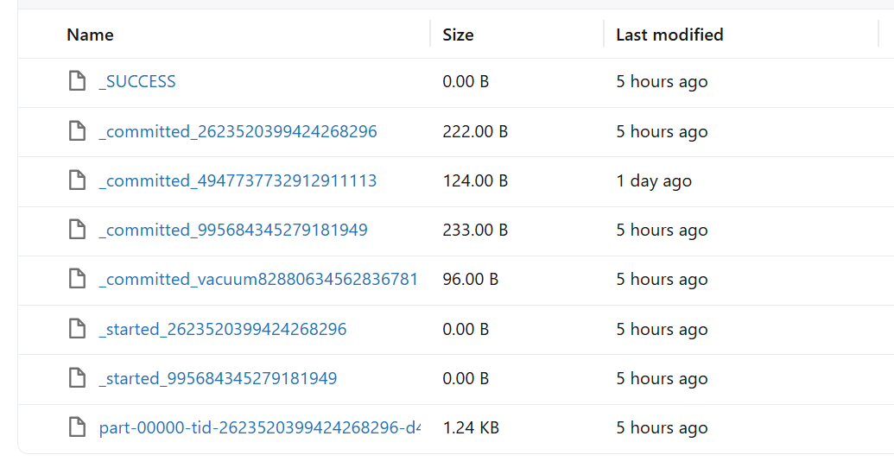
• _SUCCESS This file means the Spark job completed successfully. If this file is present, the write operation finished without error.
• part-00000-....parquet This is the actual data file. Each Spark partition writes one part file. If there are 4 partitions, you will see 4 part files.
• _started_... Indicates that a task started writing data.
• _committed_... Indicates that the task successfully completed and committed the write.
• _committed_vacuum... Related to internal metadata cleanup (mainly in managed environments like Databricks).

Slide 26
File / Pattern | File Type | Created By | What It Contains | Role in Spark
part-00000-xxxx.parquet | Data File | Spark Executor | Actual table rows & columns (Parquet format) | Stores processed DataFrame data
part-00001-xxxx.parquet (if multiple partitions) | Data File | Spark Executor | Additional partition data | Enables parallel writing
_SUCCESS | Marker File | Spark Driver | Empty (0 bytes) | Confirms job completed successfully
_started_xxx | Metadata | Spark Commit Protocol | Start transaction info | Indicates write operation started
_committed_xxx | Metadata | Spark Commit Protocol | Commit transaction info | Confirms data write was committed
_committed_vacuum_xxx | Metadata | Spark | Cleanup/optimization tracking | Used for file management consistency

